Slide 1
Covid 19 Tweets EDA | Topic modeling
BIS 634
Venugopal Bhatia

Slide 2
Contents
The Data
Preprocessing
EDA
Sentiment Analysis
Topic Model
Web Interface

Slide 3
The Data
41157 tweets manually annotated with sentiment
Contains the following columns:
'UserName’: Anonymized
'ScreenName’: Anonymized
'Location’: London, London,UK, California, Sacramento, CA, worldwide
'TweetAt’: Dates
'OriginalTweet’: 'As news of the region\x92s first confirmed COVID-19 case came out of Sullivan County last week, people flocked to area stores to purchase cleaning supplies, hand sanitizer, food, toilet paper and other goods, @Tim_Dodson reports https://t.co/cfXch7a2lU'
'Sentiment’: Extremely Negative to Extremely Positive

Slide 4
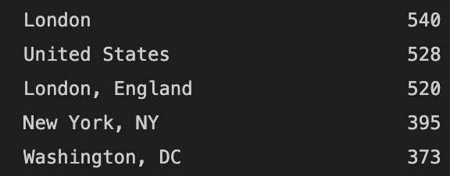
Data Summary
Dataset size: 41157
21% location values null. 1% are London alone, 12220 unique.
All tweets unique.
Dates between Jan and Dec 2020 though most data for March 16 to April 14. Rest of the data for the 4th of each month.
Data follows FAIR principles
Data Source: Kaggle, Author: Aman Miglani
License: Data files © Original Authors

Slide 5
Preprocessing
Location by far the dirtiest column.
~12000 locations with some values that are not locations at all.
Dates had just two rows with NaT.
Tweets required preprocessing to get links, mentions and hashtags.

Slide 6
Locations
Locations cleaned, special characters, less than 2 char and null values removed.
Really wanted to be able to look at data using location AND time.
Looked at location frequency. The more frequently a place occurs the more likely it is a genuine location.
Dashboard has a dropdown with search and multiselect to narrow down the location user is looking for.

Slide 7
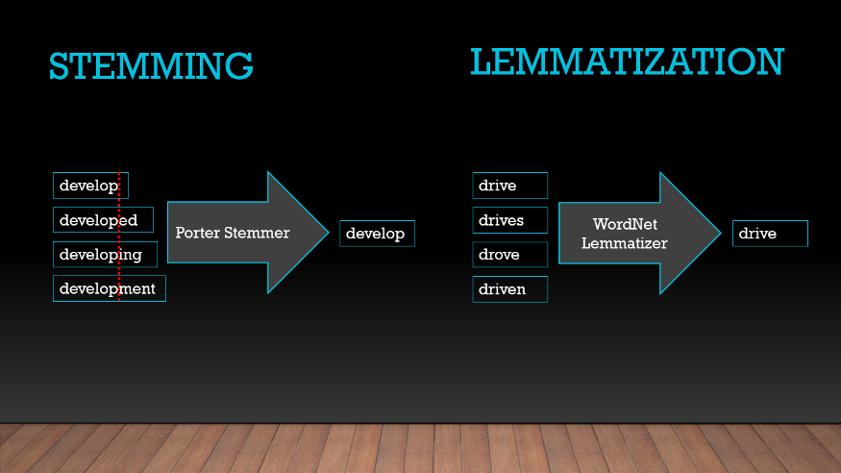
Tweets
Mentions, Hashtags and links extracted.
Tweets tokenized stopwords removed and lemmatized.
POS tagging followed by Lemmatization: Bring word down to its base form/Lemma.
am, are, is -> be car, cars, car's, cars’ -> car

Slide 8
EDA
Can look at region wise data
For each subset of regions following visualizations are present:
Tweets over time
Word cloud for each sentiment.
Most frequent words. Can choose n = 10,20,50,100
Top mentions. Threshold n = 100, 50, 20, 10 , 1
Histograms for probability density of each sentiment.

Slide 9
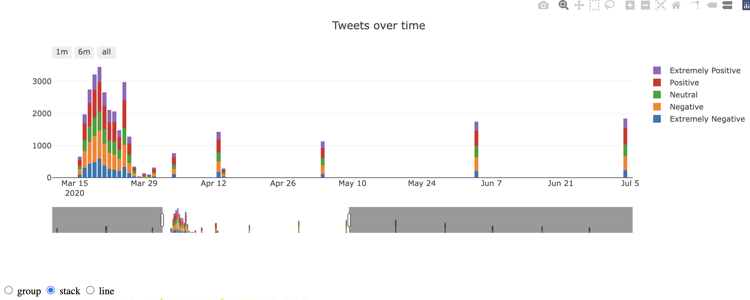
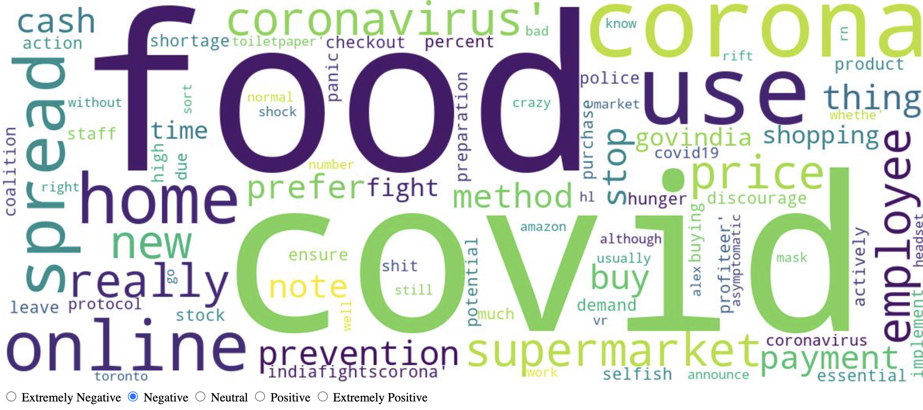
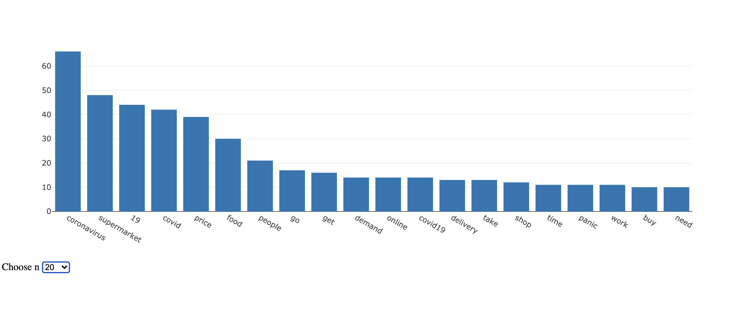
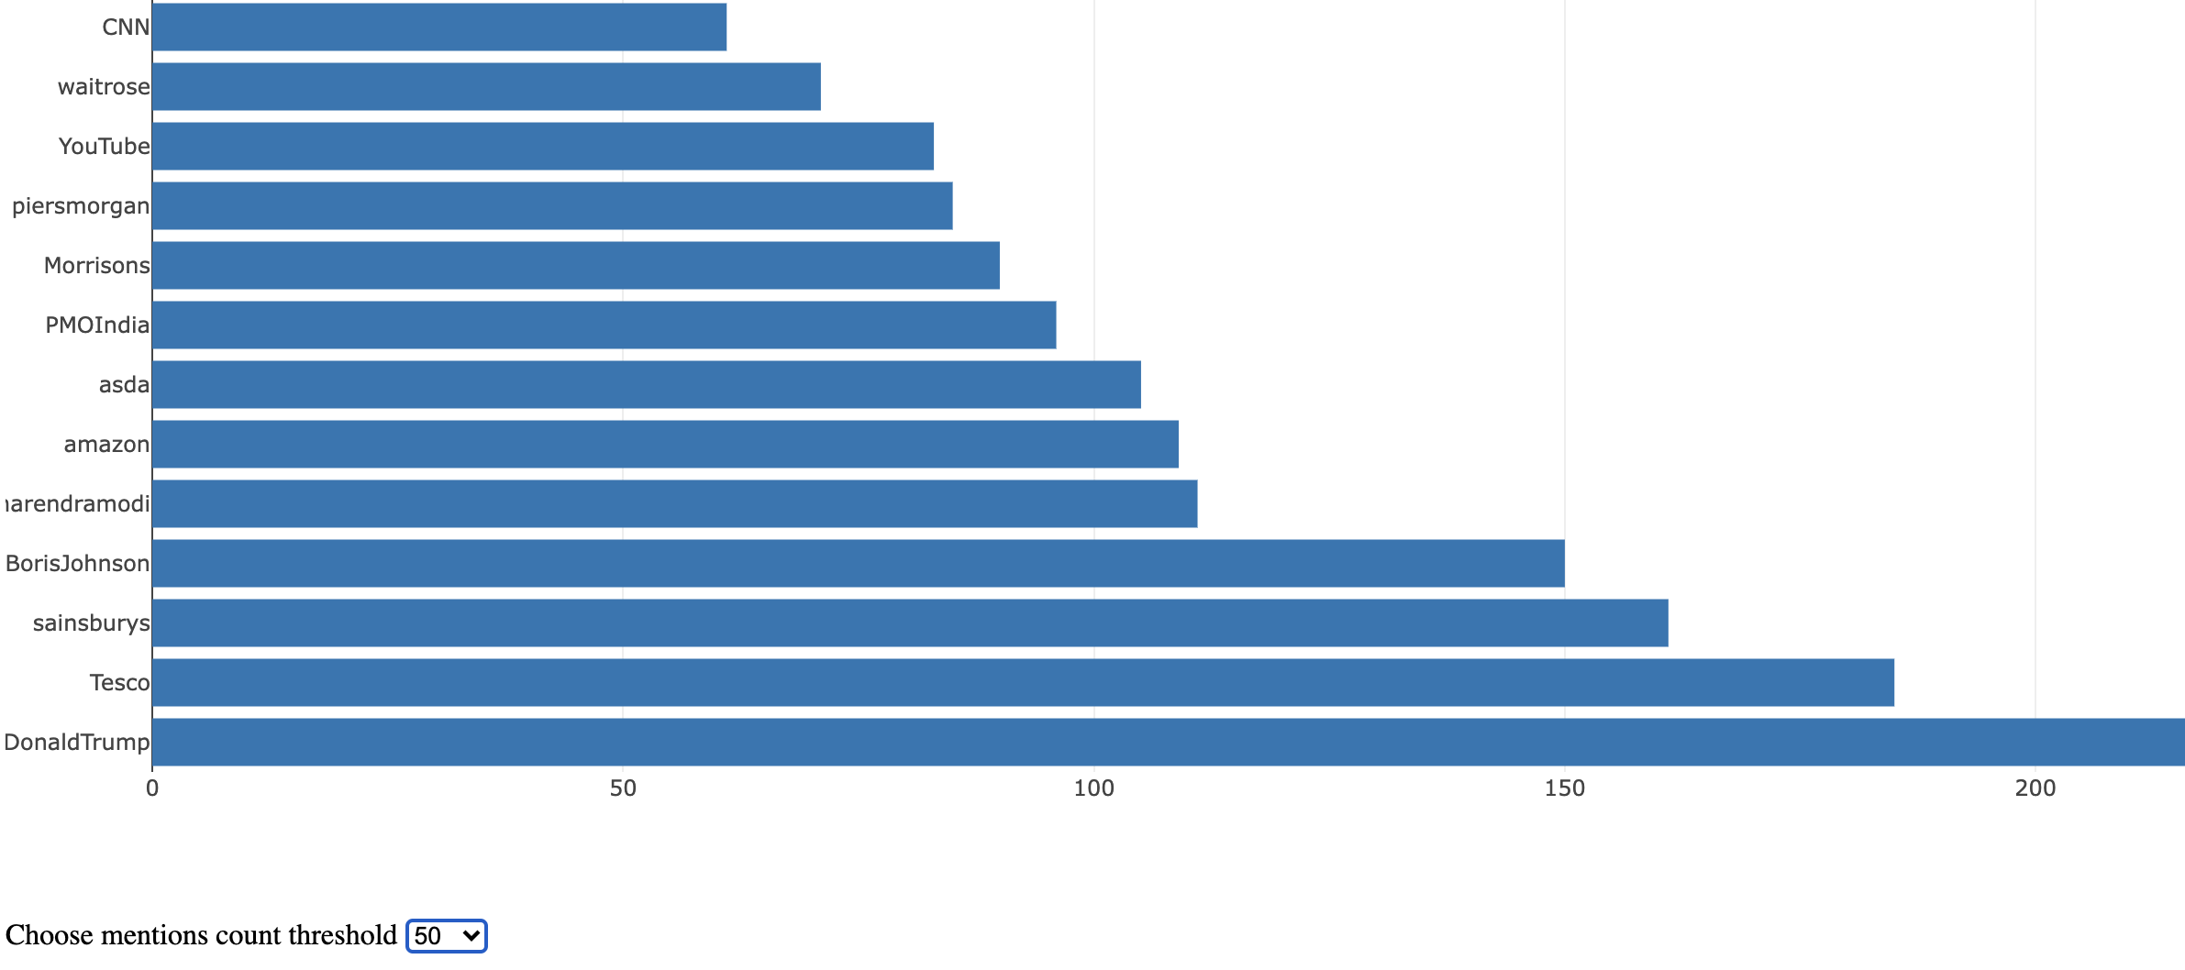
Visualizations

Slide 10
Sentiment Analysis
All previous cleaning of tweets done with intention of training my own classifier.
CountVectorizer for selecting top n words by frequency and transforming data to matrices with token counts depending on presence of features.
HyperOpt: Bayesian Inference for hyperparameter optimization.
Uses Tree of Parzen Estimators.
Ensemble had svm, knn, decision tree, random forest, naive bayes
Uniform priors assigned for hyperparameters of each of these algorithms.
This analysis however didn’t work out very well. Maybe issue with annotations or the fact that discerning extremely positive/negative from positive/negative difficult.

Slide 11
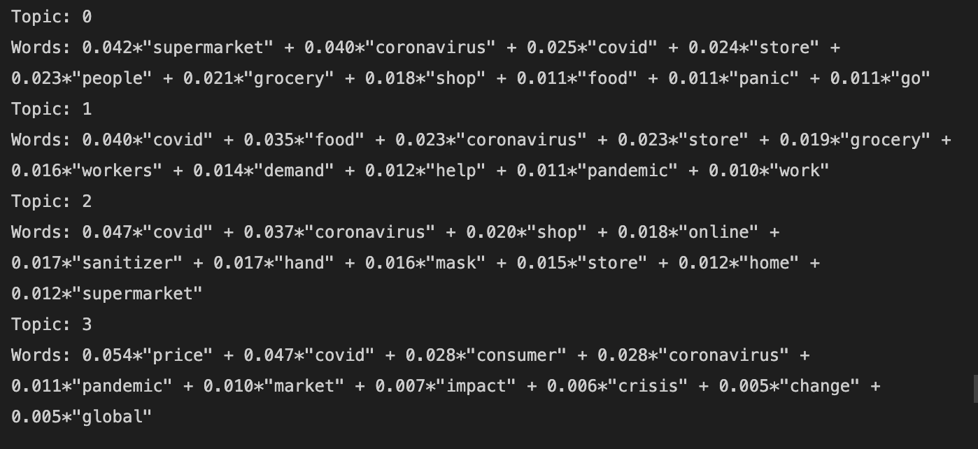
Topic Model
Latent Dirichlet Analysis done for topic modeling
4 topics

Slide 12
What picture does the data paint?
Seems like maybe more data collection around March done on purpose since that’s when lockdowns happened.
Top mentions included DonaldTrump, BorisJohnson, NarendraModi, PiersMorgan and also amazon, Sainsbury and Tesco.
Topic model reflects what was on people’s minds: Loss of jobs, Panic Buying, Supply and demand disruptions and effect on global markets, online shopping of masks, hand sanitizers, supplies and groceries.
Pdf histograms show distribution of neutral tweets lengths differs from sentiment distributions and that extremely positive and extremely negative tweet length distributions look similar and so do positive and negative tweet length distributions.

Slide 13
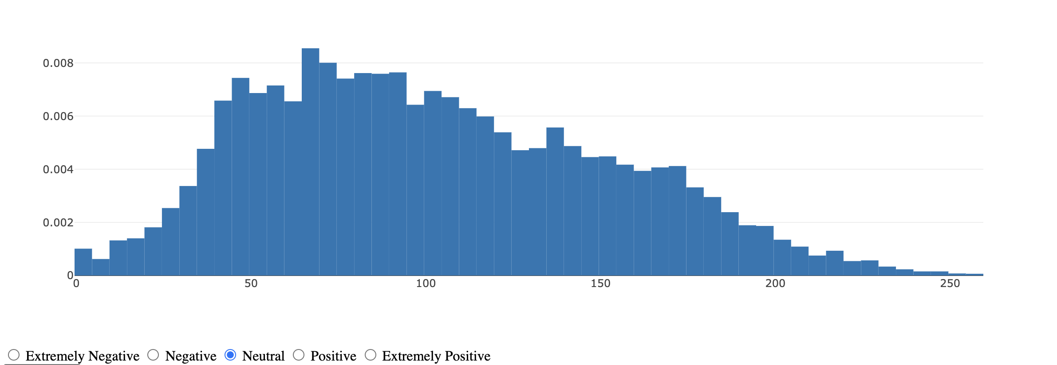
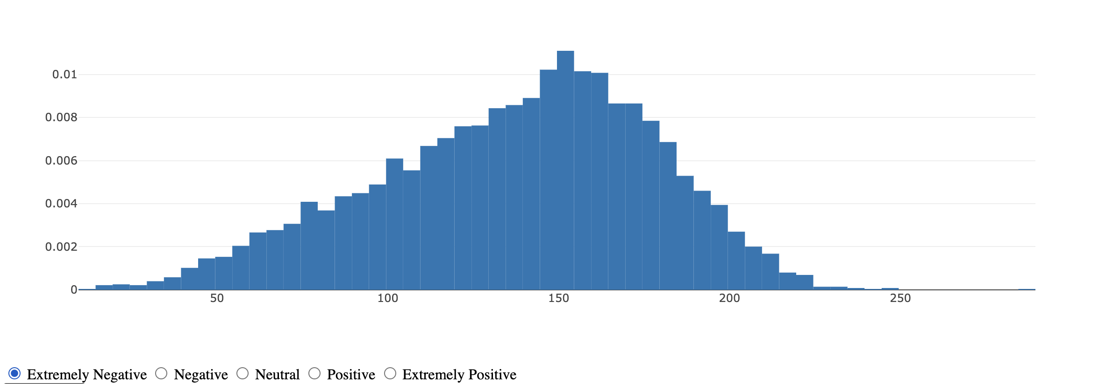
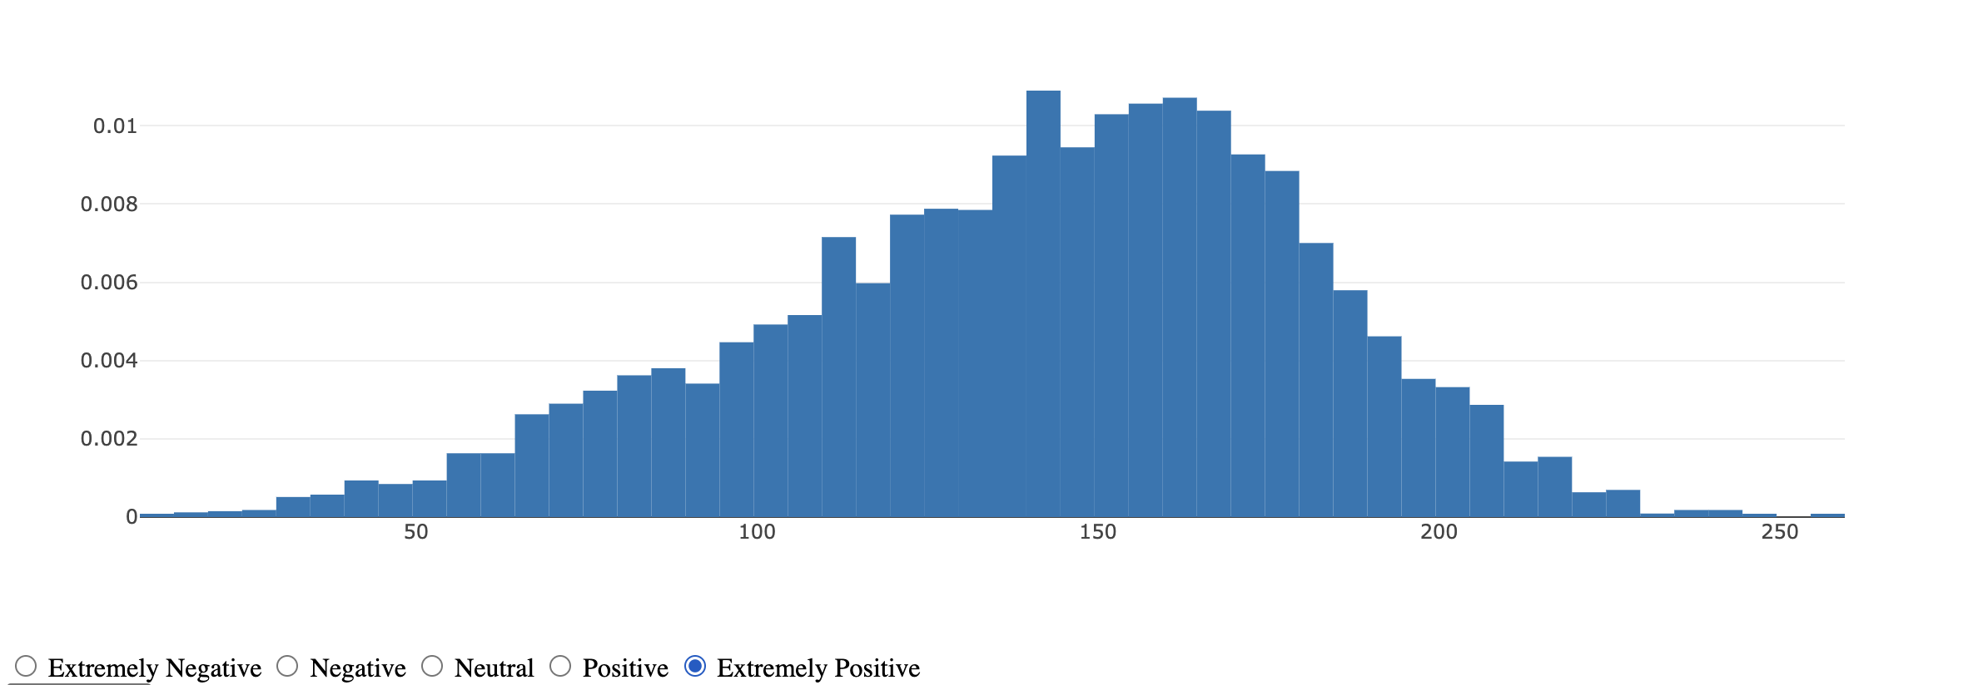
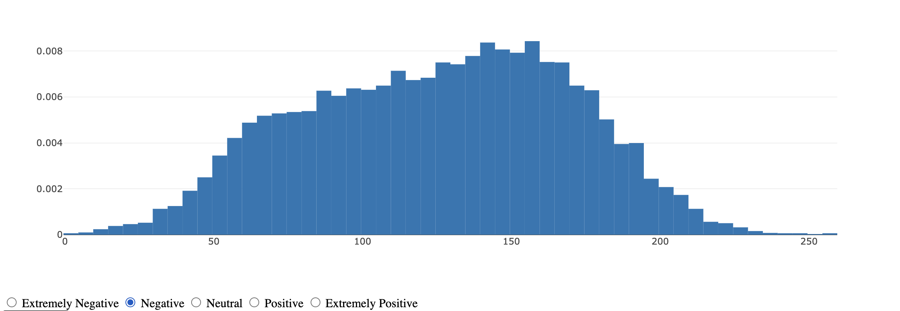
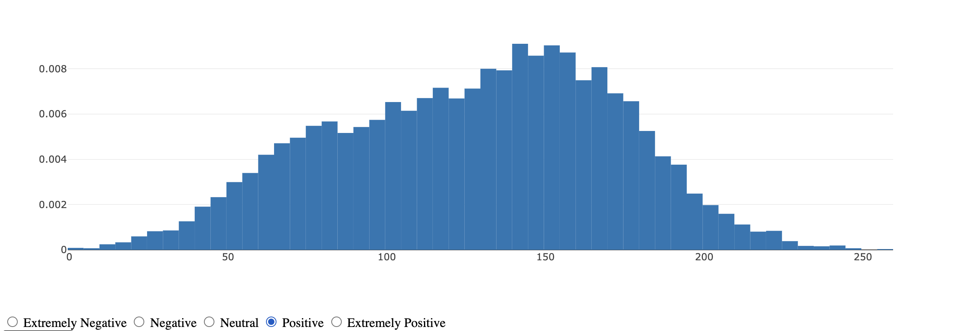

Slide 14
Demo

